Slide 1
Team B1 - Artem N., Nick V., Maria K., Olga N., Rabih A.
WORLD NEWS WEBSITE

Slide 2

LOGO DESIGN |

Slide 3
PROJECT DESCRIPTION |
“World News” website is going to display the most recent and important world news from different categories like sport, business, politics, technologies.
Logged in user will be able to see some extra categories and articles, otherwise, he/she will see just general information.
https://tinyurl.com/y5nrueeo - MOBILE LIVE
https://tinyurl.com/y3qn2xd6 - DESKTOP LIVE

Slide 4
USER/ADMIN |
Login/Registration page will be implemented in this project where there will be admins and users.
Admins will be able to login into the admin panel, make any changes relating to CRUD for each feature and also view as a user. However, users will be able to view the features, make changes to their own profile page.
All users who register will have the user type privilege and only admins will be able to change it to admin or keep it as it is. Moreover, passwords will be encrypted using hash which makes it secure to save the password in the database as a hashable password.

Slide 5
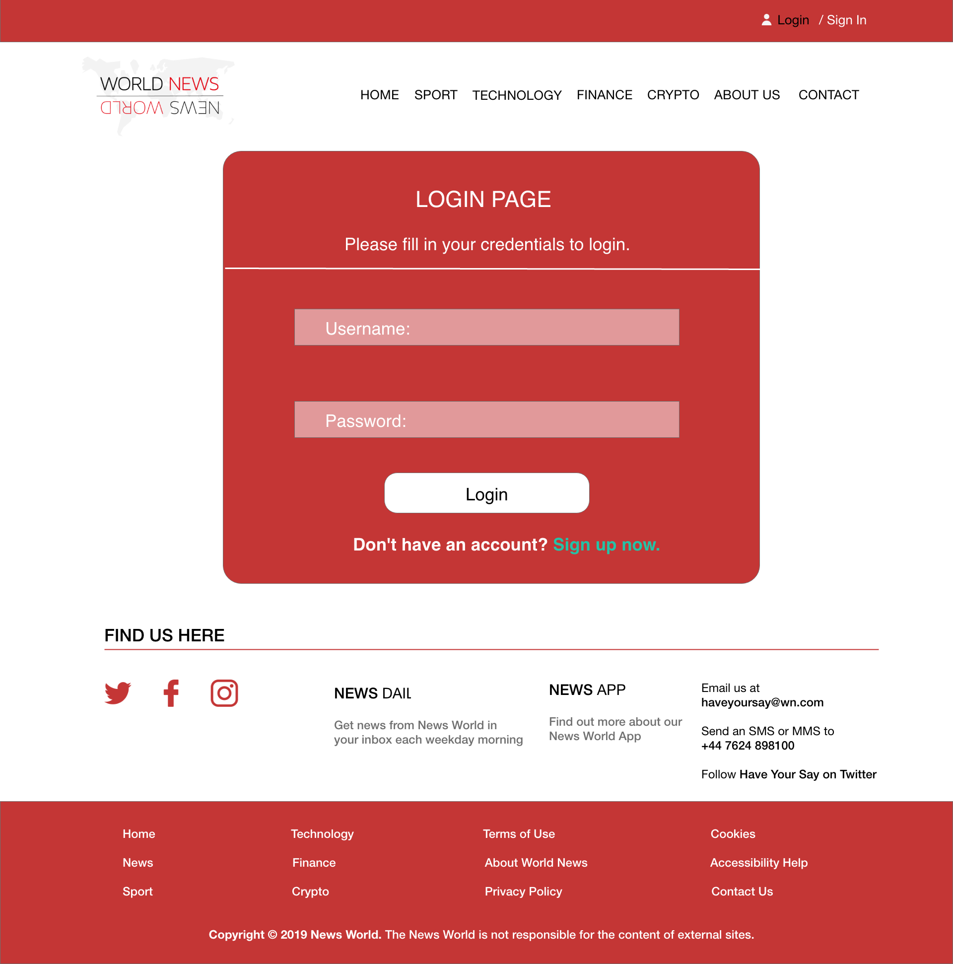
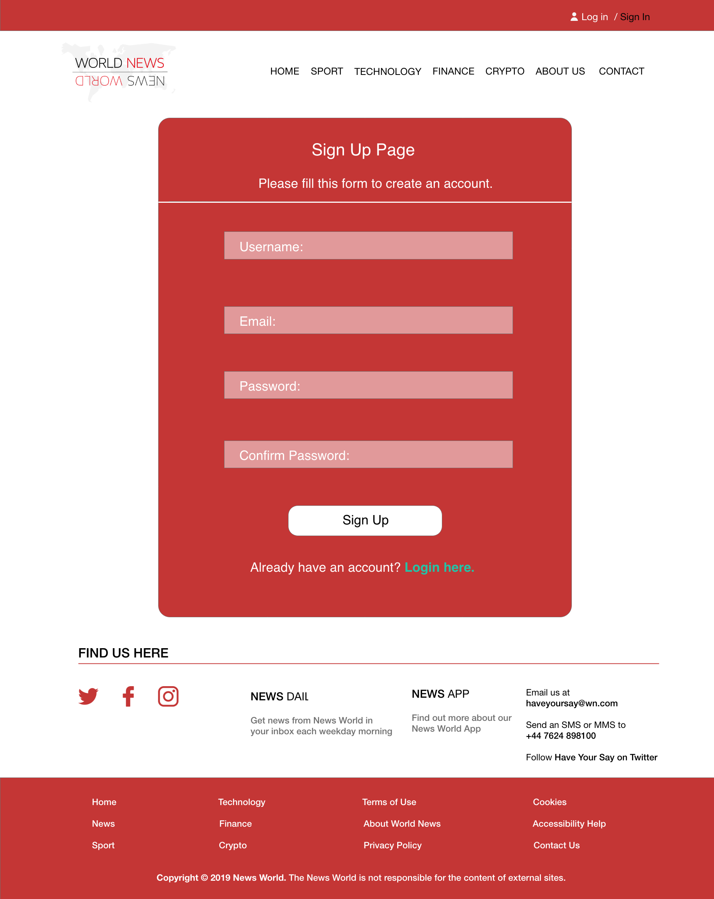
Login / Sign In |

Slide 6
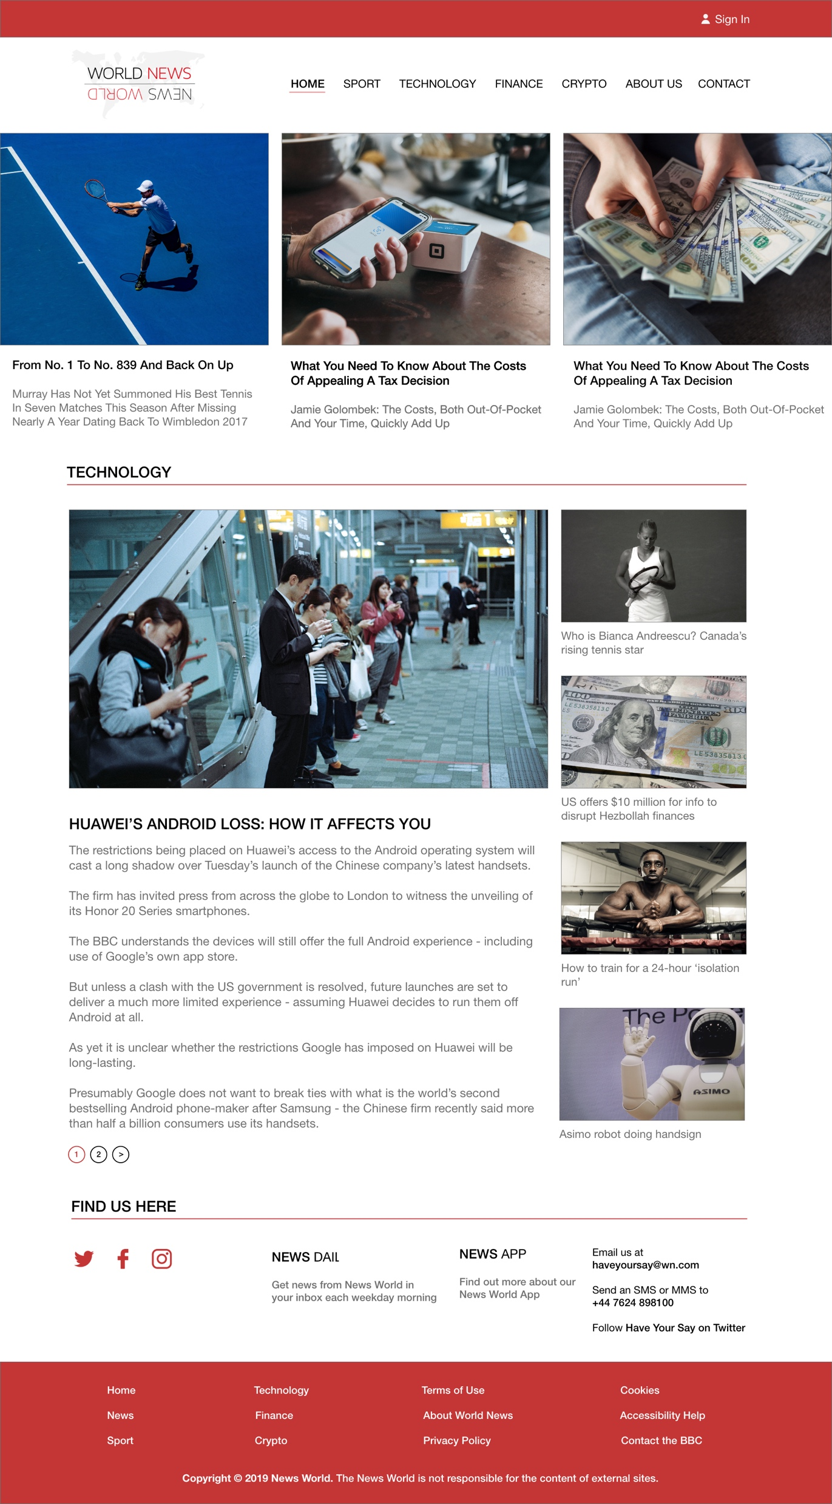


DESKTOP MOCK-UP |

Slide 7
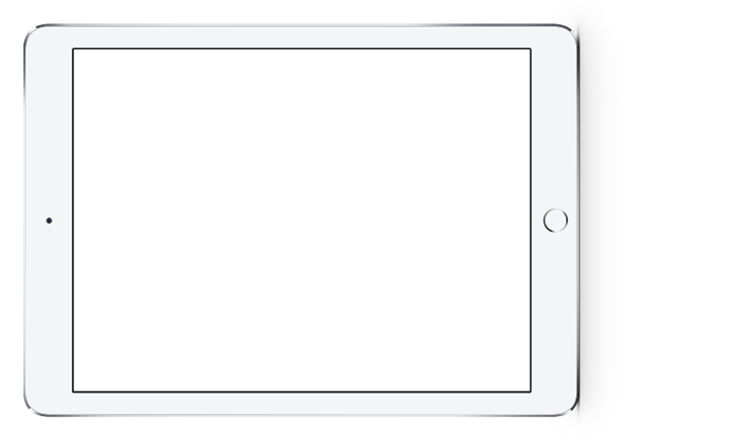

TABLET LANDSCAPE MOCK-UP |

Slide 8
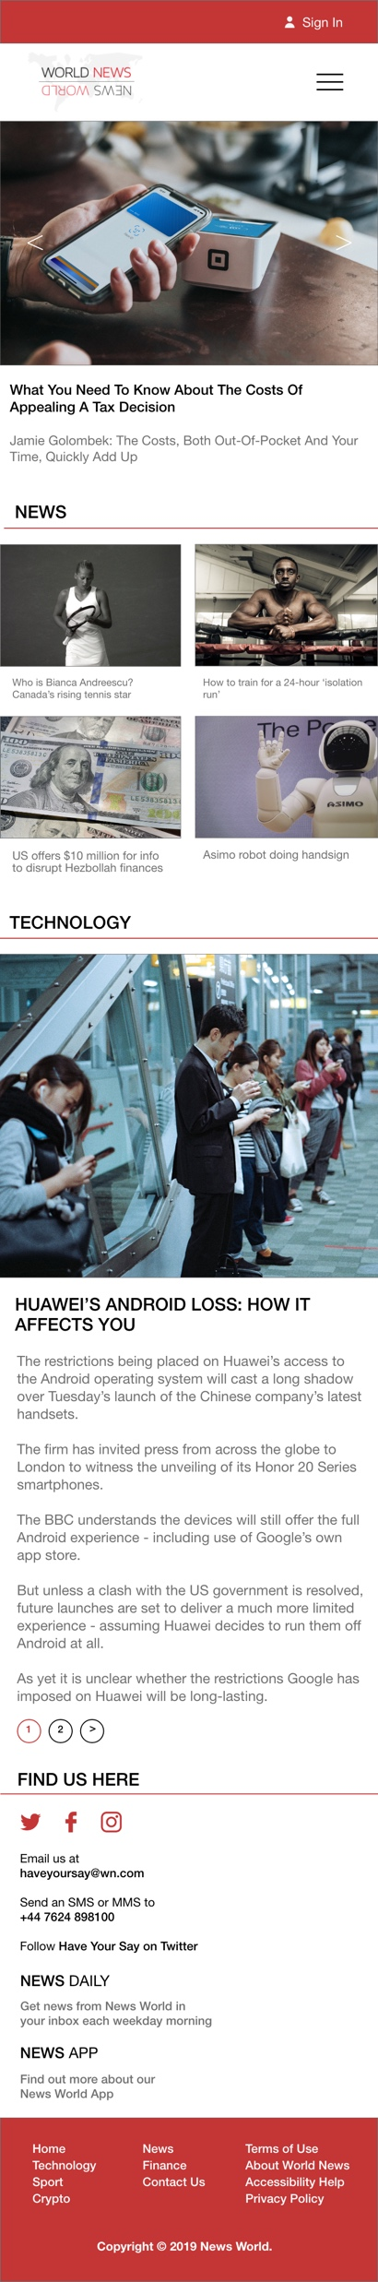


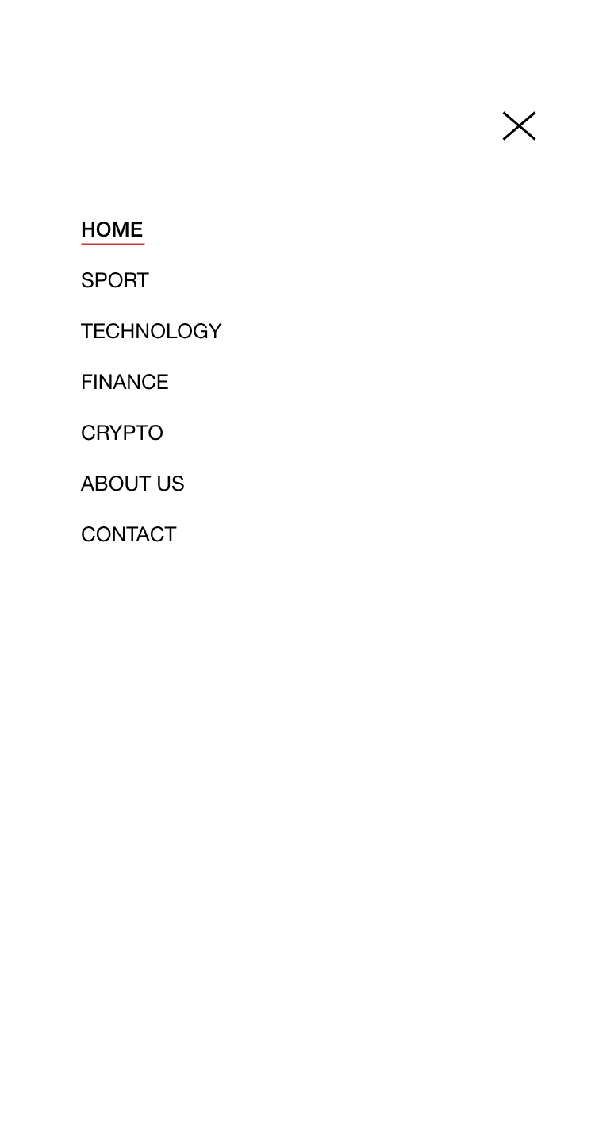
MOBILE MOCK-UP |

Slide 9
INTERFACE DESIGN |
RESPONSIVE INTERFACE DESIGN

Slide 10
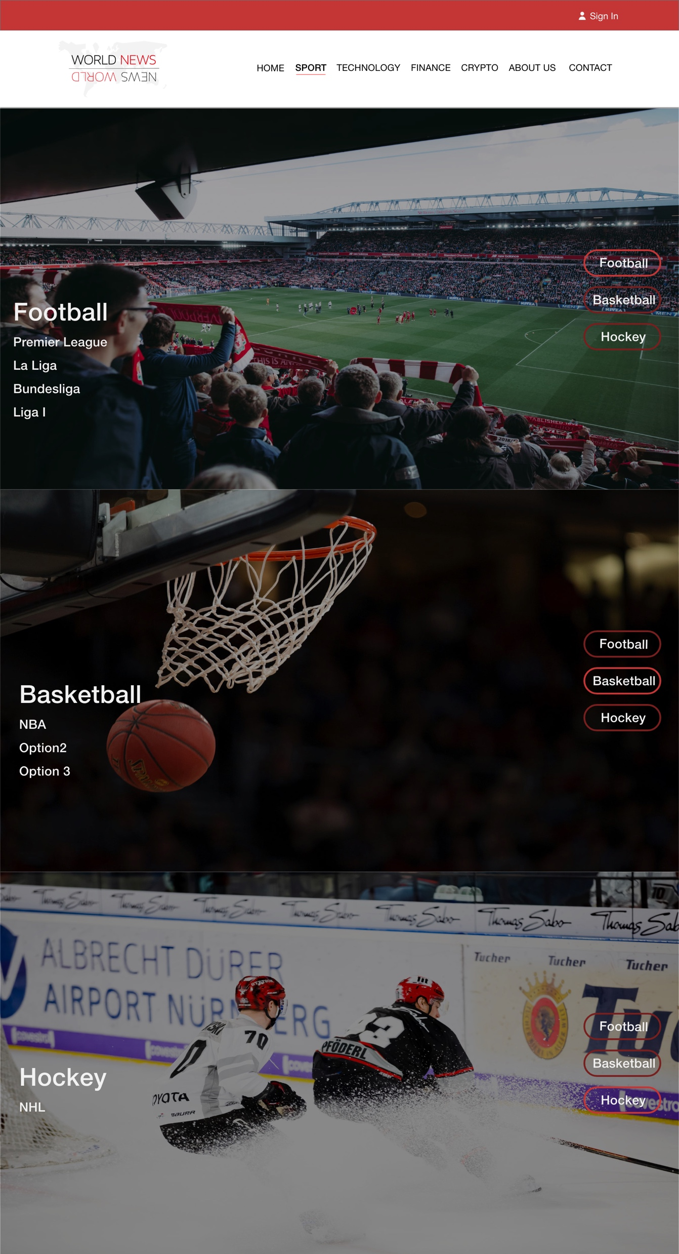
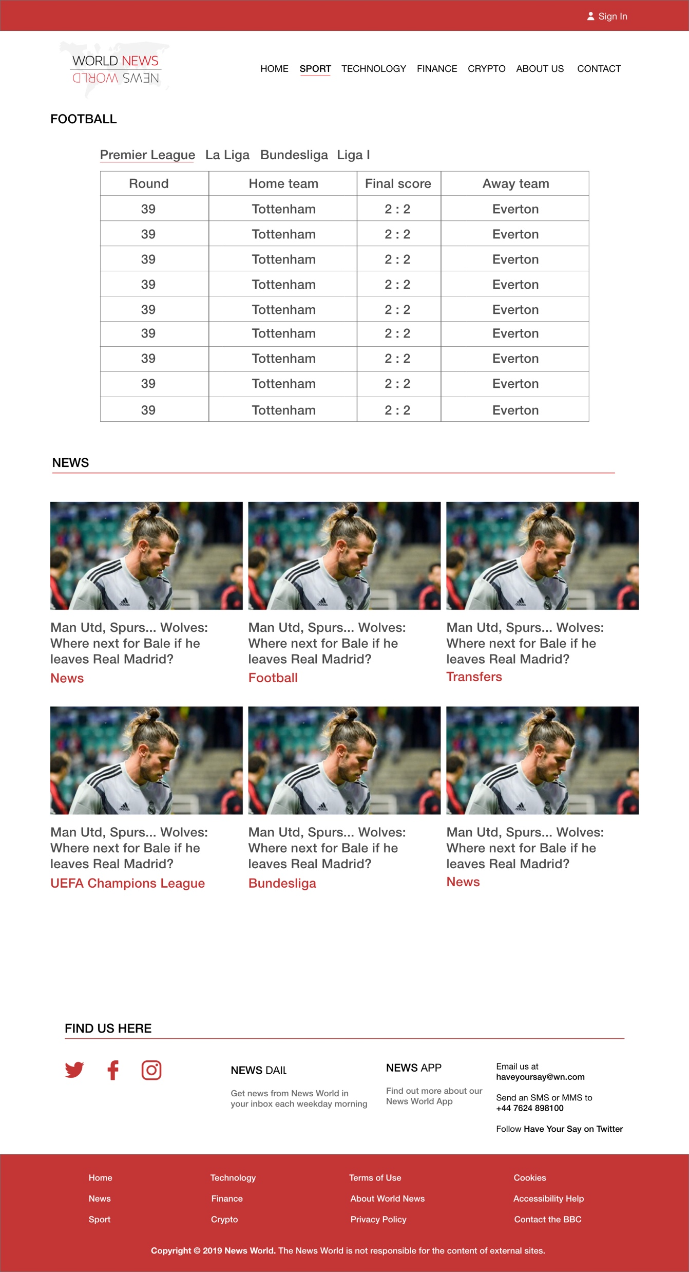
SPORT |
There are 3 categories: Football, Basketball, and Hockey.
There is a data set with results on the top of each index pages.
Admin can use API for creating news pages or make articles using the admin panel. Football API
Basketball API
Hockey API

Slide 11
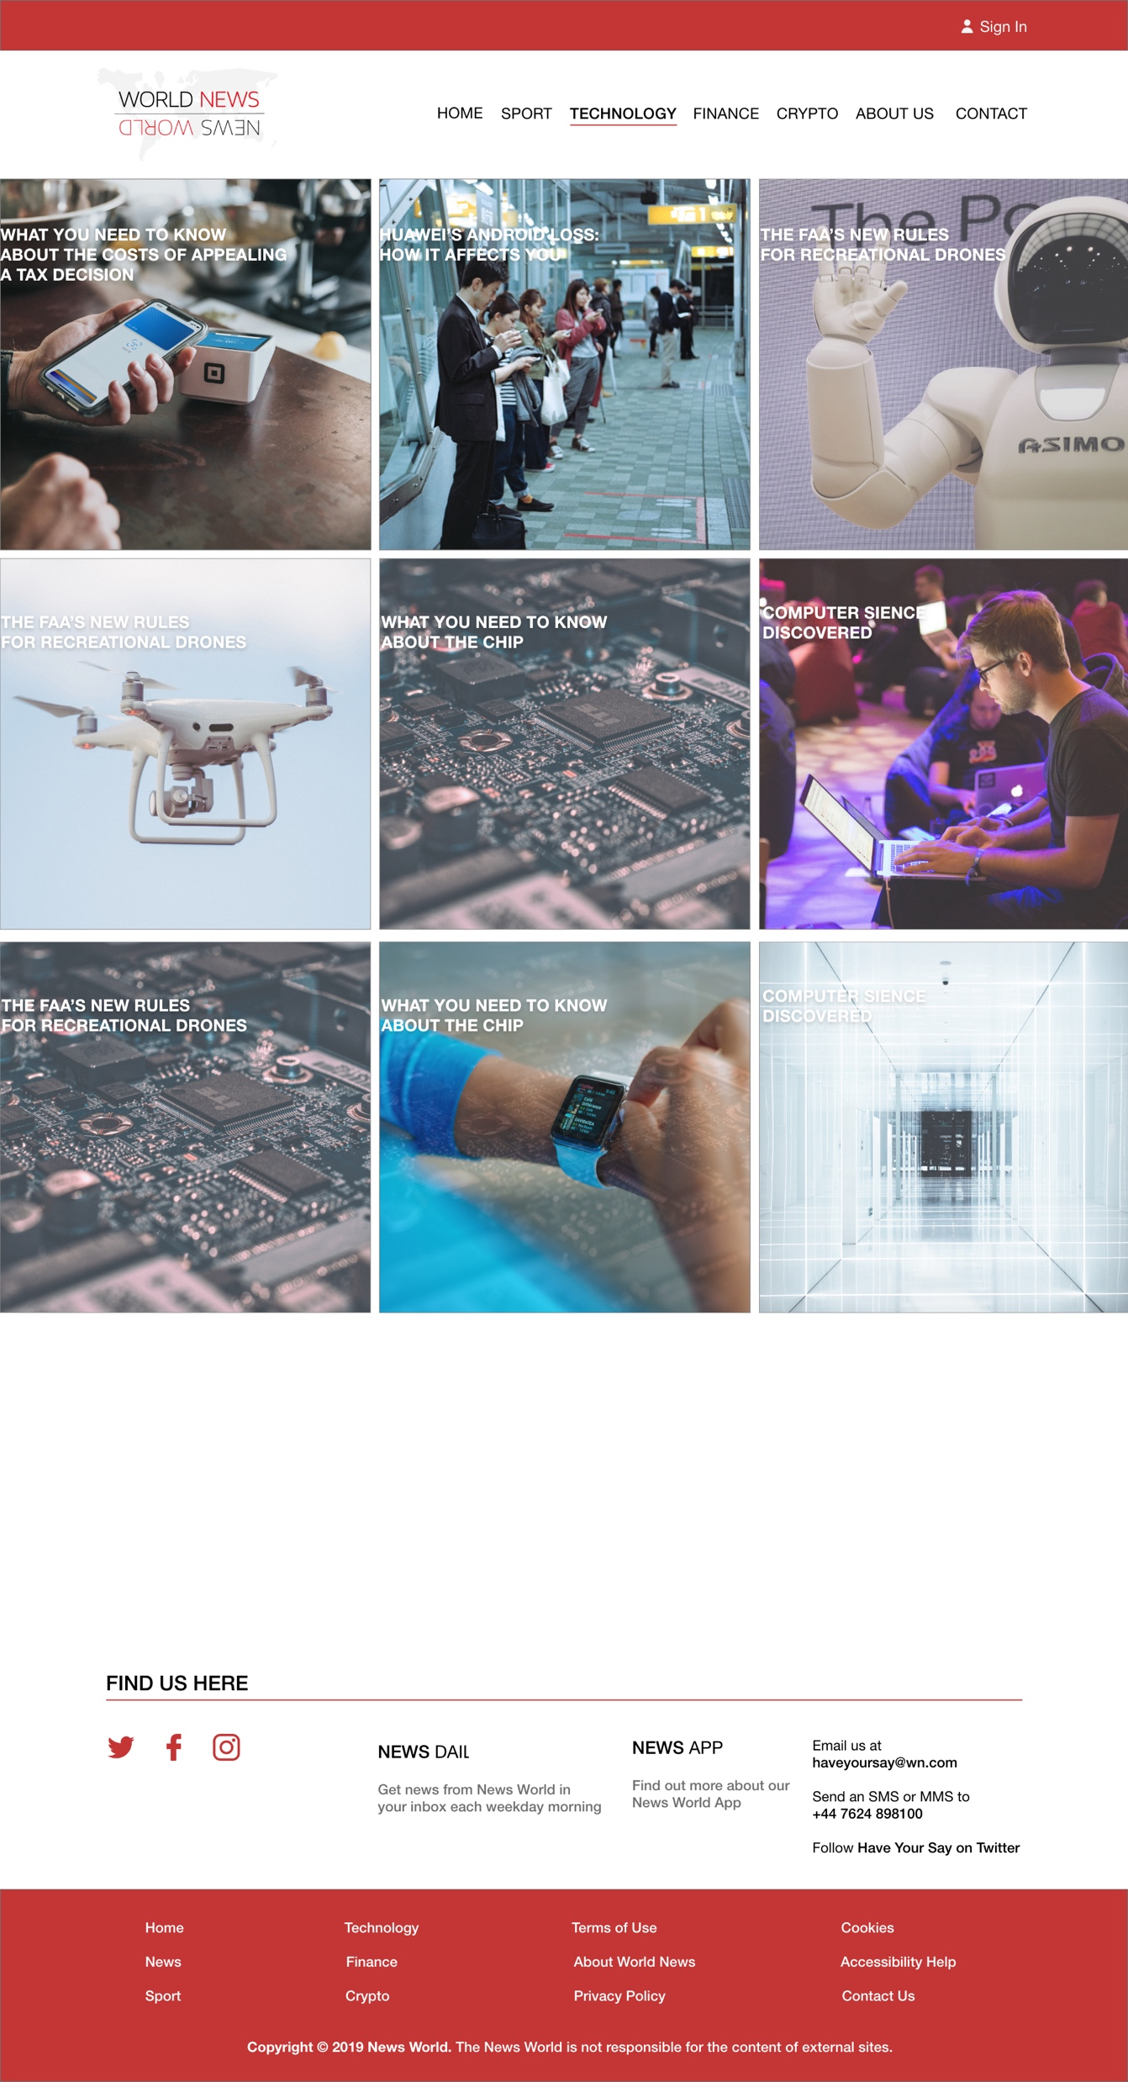
TECHNOLOGY |
This page will be displaying the latest technology news and articles. We will have CRUD to add new content on the page. Only admin will be able to create his/her own articles.
Google News API

Slide 12
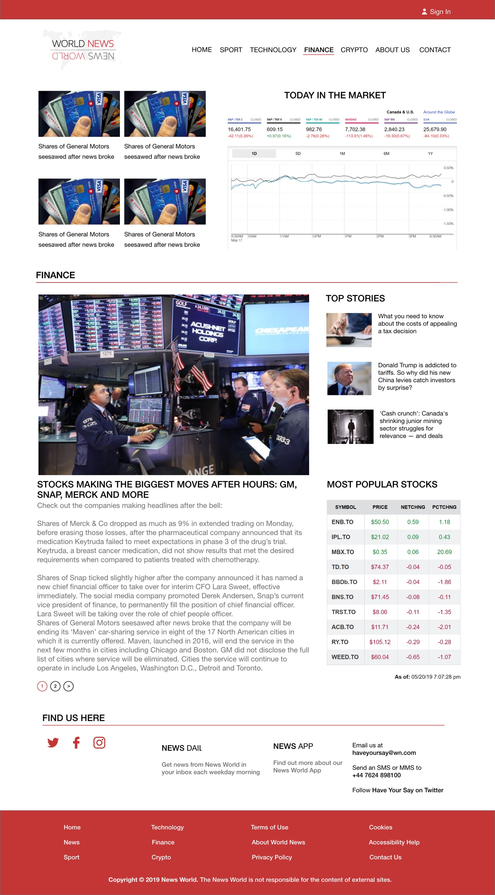
FINANCE |
This page will be displaying the latest financial news and articles. This page has an admin side with CRUD operations. Admin can create own articles and users can live a comment.
Google News API

Slide 13
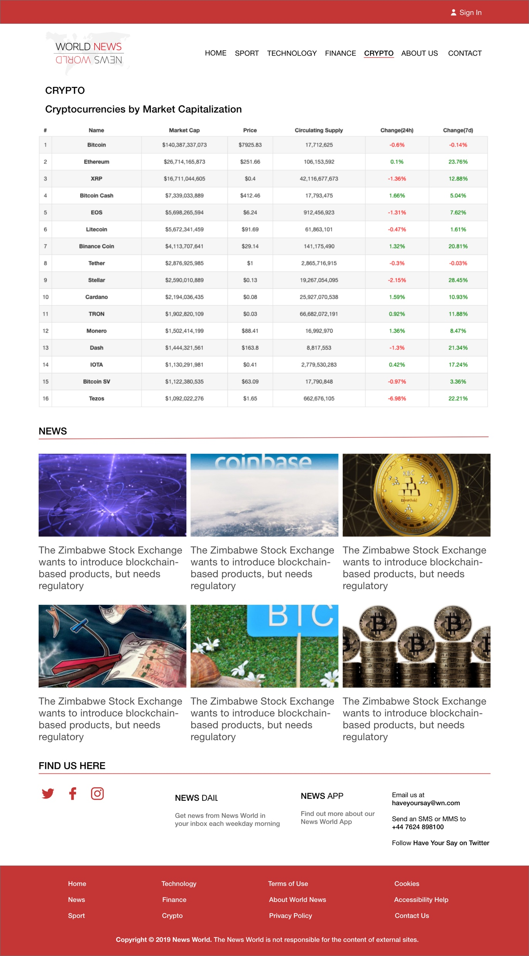
CRYPTO |
On this page admin will be able to add some new unique articles.
Also, Crypto API news will be using and all of the articles will be updated with AJAX each hour. Logged in user will be able to see some extra information about crypto trading (another API from different (stock exchanges like Bitmex.com and Binance.com). CryptoCompare.com API
BitMex API
BitFinex API

